Slide 1



MECH 527 - Mechatronic System Design Project
Data Harvesting, Automation, and Controls
By Jonas Chianu

Slide 2
Introduction/Overview
Three Projects:
Project A: MECH 540B Lab Upgrade
Project B: MANU Automation Kit Controls
Project C: Manufacturing Equipment Data Harvesting
Notes:
Project A: Updating the MECH 540B FPGA labs. Goal: Upgrade the labs to a newer version of quartus (programmable logic device design software) and change the lab instructions.
Project B: Working with the MANU 386 automation kit and controlling the position of the pneumatic piston by automating the opening and closing of the pneumatic valves using PLC ladder logic.
Project C: This project involves data harvesting/acquisition from equipment in FF219 lab. Goal: Create a list of communication interfaces for each device and find out relevant data related to performance and diagnostic that can be extracted from each device. A SCADA application was also implemented for one of the devices to show an example of how tags can be extracted and monitored using a data server.

Slide 3
Project A: MECH 540B Lab Upgrade

Slide 4
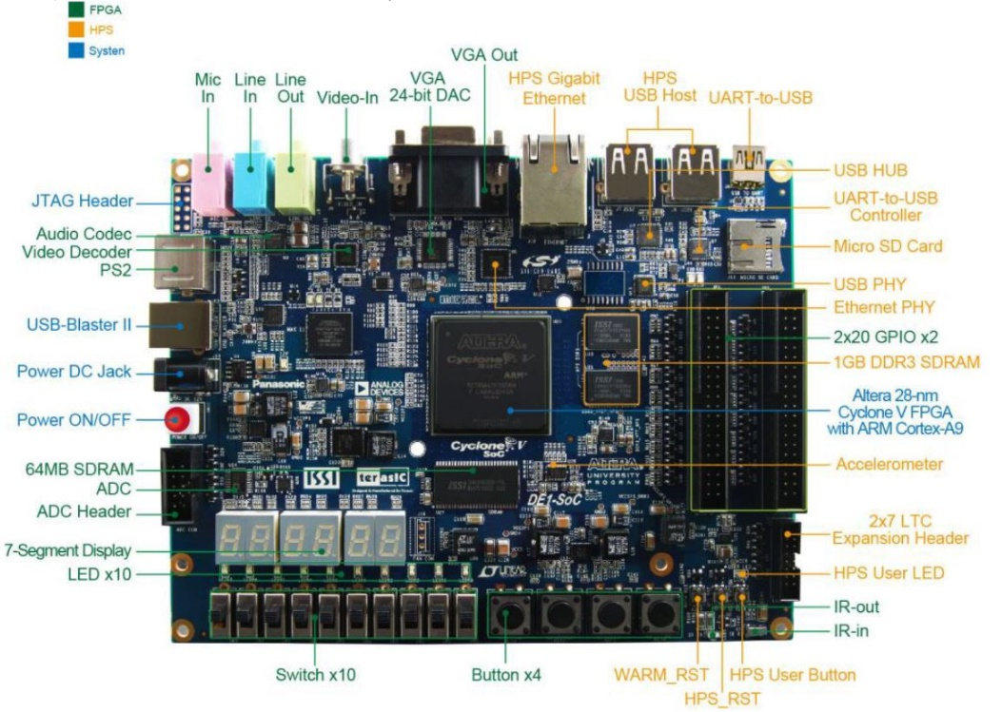

Project Overview
The project involves upgrading the FPGA labs 3, 4, and 5 of MECH 540B.
Lab 3: Introduction to FPGA
Lab 4: FPGA and ADC
Lab 5: Building a Microcontroller (MCU)

Slide 5
Quartus Installation
Quartus Prime Edition 20 Installation
Nios II software build tool
Install Eclipse C/C++ Development Tooling (CDT)
Install Windows Subsystem (WS) 1 for Linux
Execute a couple commands in Ubuntu shell
Notes:
Nios II must be manually installed
CDT: Eclipse IDE
WS: the ability to run a GNU/Linux environment directly on Windows, unmodified, without the overhead of a traditional virtual machine or dual-boot setup

Slide 6
Lab 3: Introduction to FPGA
No Changes to Lab instructions
Changes to “My First FPGA” guide

Slide 7
Lab 4: Pairing FPGA with an ADC
Changes:
TalkBack feature is automatically actively
SignalTap name was changed
Notes:
Talkback: This feature will allow the student to use many licensed features of the software
SignalTap II -> SignalTap

Slide 8
Lab 5: Building a Microcontroller
Changes:
Nios II had to be manually installed
QSYS was renamed to Platform Designer
Nios II had to be run from the Nios II command shell
System ID checks, on Nios II “Run Configurations”, had to be checked.
Notes:
QSYS: a tool for combining IP cores on common buses

Slide 9
Project B: MANU Automation Kit Controls

Slide 10
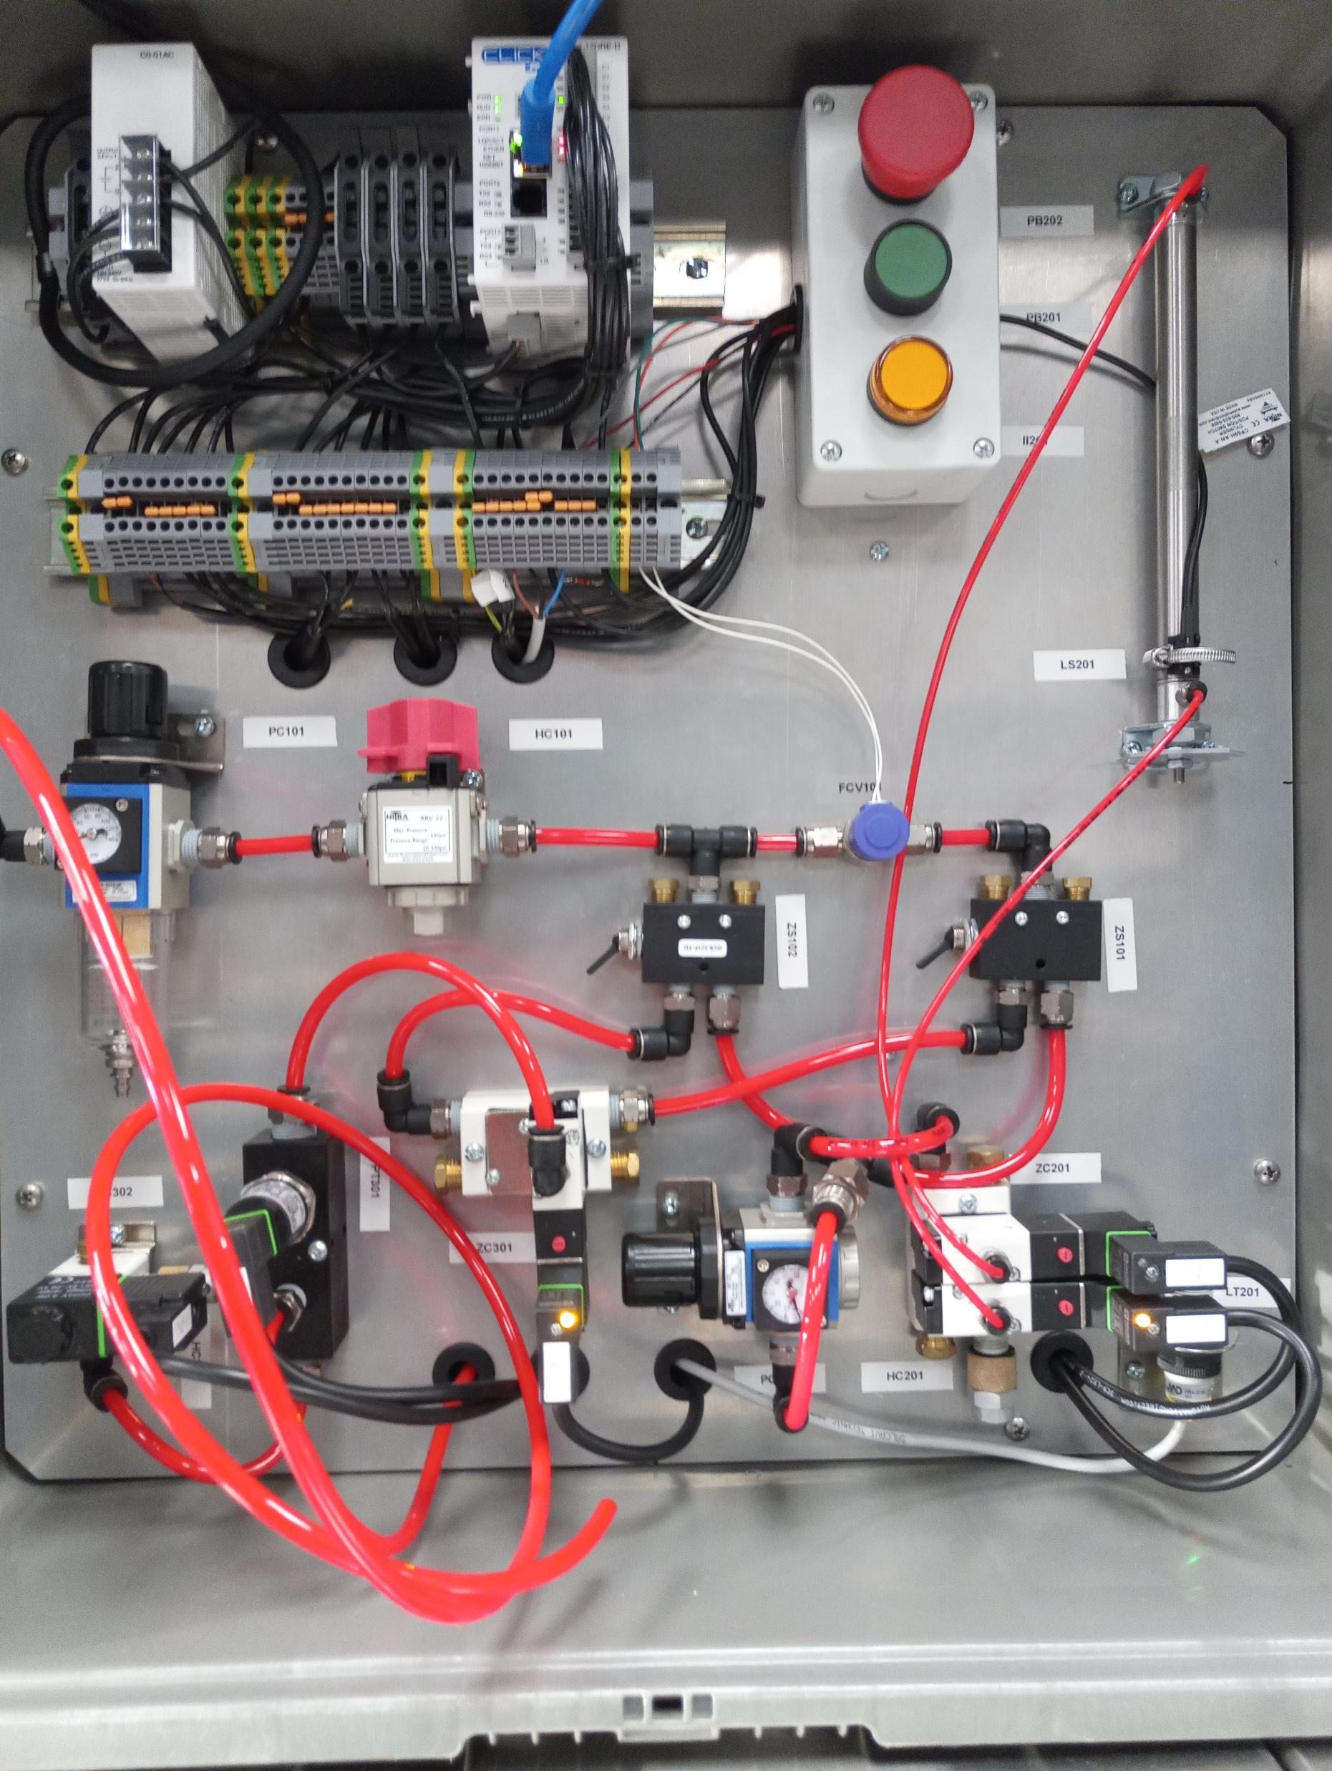
Automation Kit Overview
Goal: The discrete control of pneumatic valves for controlling the position level of a pneumatic cylinder
The effects of gravity in a vertical position were accounted for.
PLC ladder logic programming using ClickPLC
Notes:
PLC
Two pneumatic valves
Flow control valve
Position sensor
Pressure sensor

Slide 11
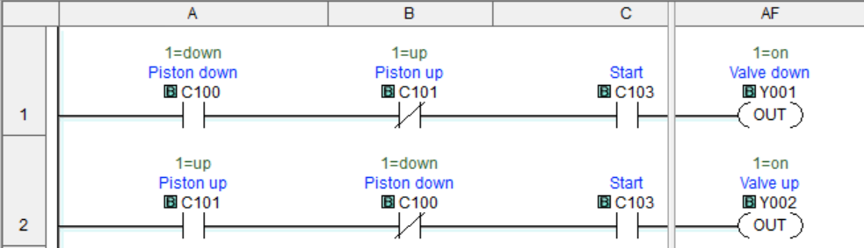
Control Logic: Pneumatic Valve Operation

Slide 12
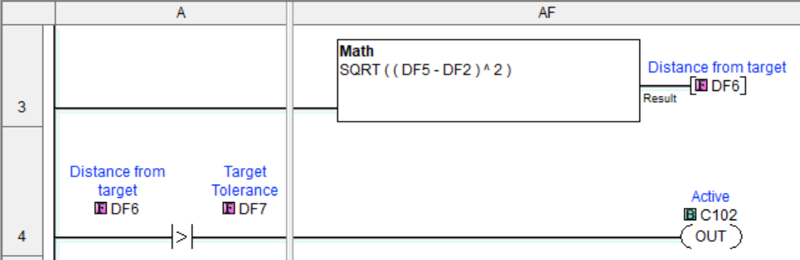
Control Logic: Position and Tolerance

Slide 13
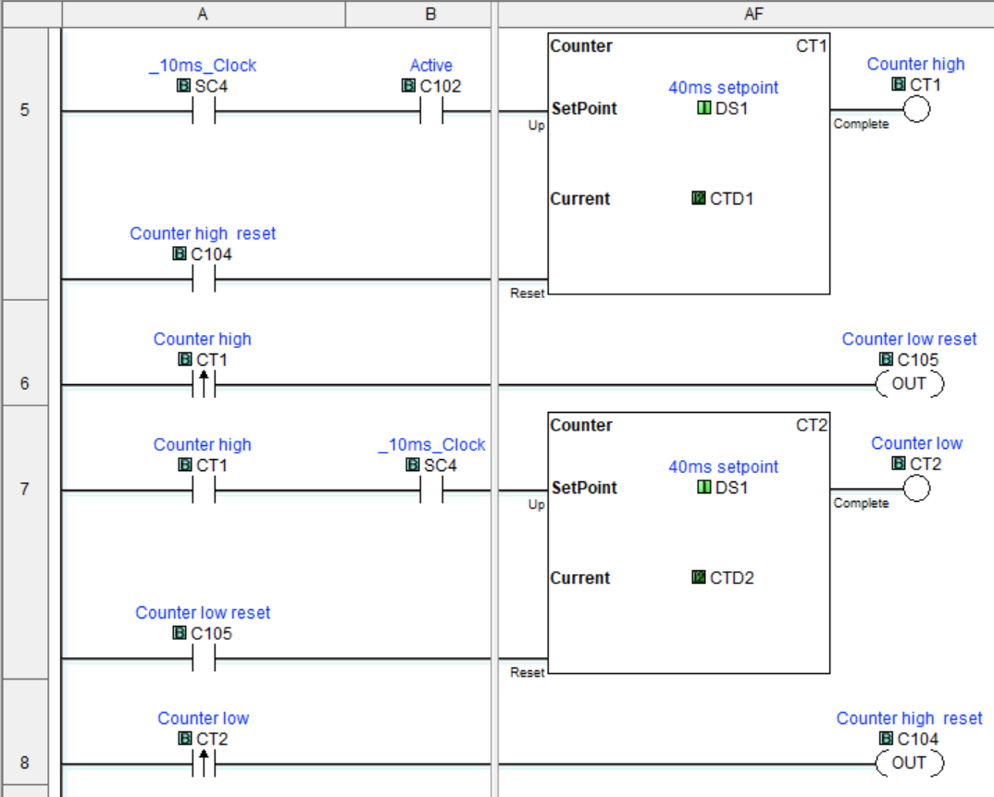
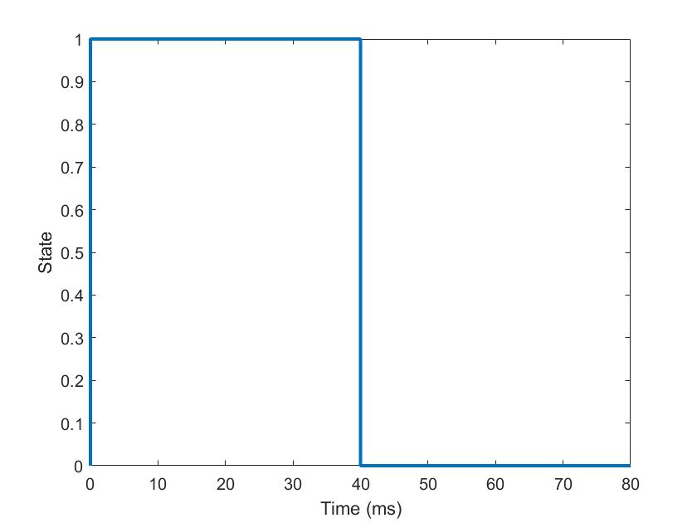
Control Logic: Counter Timing Logic
CT1 Low = Valves open
Notes:
Valves being open for 2-3 seconds too long
10ms clock connected to a counter.

Slide 14
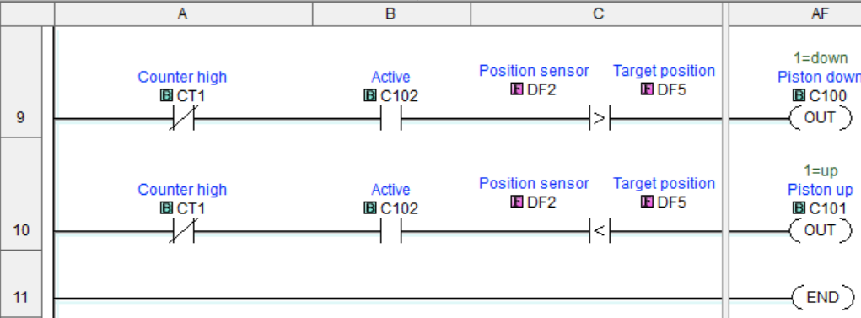
Control Logic: Piston Control Logic

Slide 15
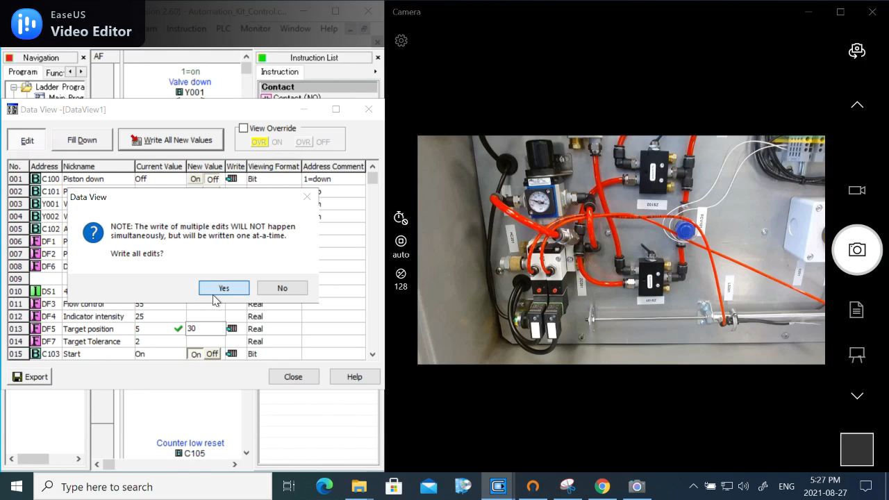
Horizontal: 40mm – 161 mm (2 – 30), Tolerance: +/-8mm (2)

Slide 16

Horizontal: 40mm – 161 mm (2 – 30), Tolerance: +/-20mm (5)

Slide 17
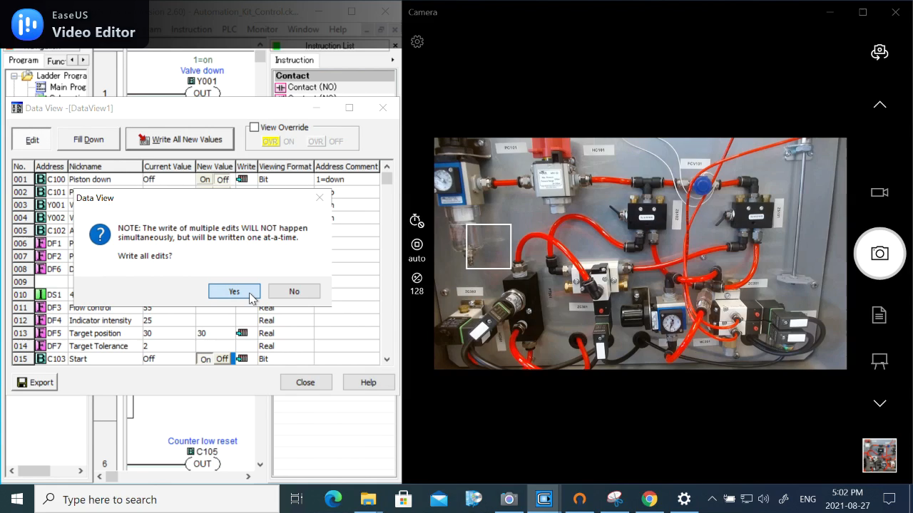
Vertical: 40mm – 161 mm (2 – 30), Tolerance: +/-8mm (2)

Slide 18
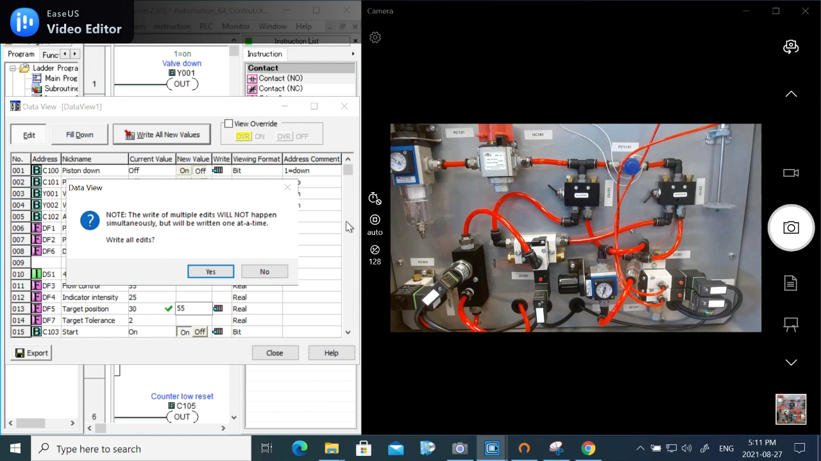
Vertical: 161mm – 270 mm (30 – 55), Tolerance: +/-8mm (2)

Slide 19
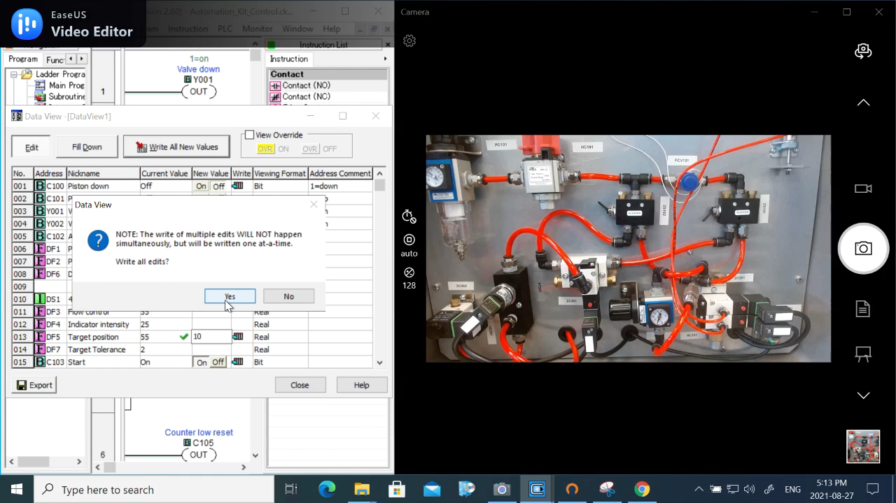
Vertical: 270 mm – 74 mm (55 – 10), Tolerance: +/-8mm (2)

Slide 20
Project C: Manufacturing Equipment Data Harvesting

Slide 21
Overview
Data Harvesting/acquisition of equipment in FF219 lab
Goal:
A list of communication interfaces and relevant tag/variable related to performance/diagnostic
SCADA application for injection moulding machine
List of Equipment:
BOY Injection moulding machine
Samnian Automation kit
HAAS CNC mill
Watlow Temperature and process controller (Blue M Standard Mechanical Convection Oven)
Omega microprocessor based temperature process control (for Thermolyne Furnatrol II muffle furnace)
Raise3D Pro2 Plus 3D printer
Instron Load frame

Slide 22
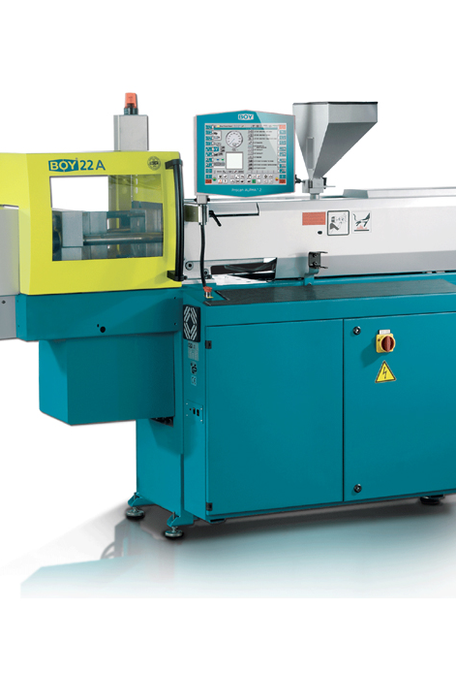
BOY Injection Moulding Machine
It used for manufacturing plastic products through means of an injection moulding process
Notes:
The equipment takes in raw plastic pellets through the feed hopper at the top. When the pellets have been melted, the screw pushes the molten plastic through the nozzle and into the mould at a very high pressure and the completed piece is then ejected.

Slide 23
Communication Technology and Tags
Communication: Ethernet OPC
All tags/variables including their addresses can be access using KEPServerEX 6 with CODESYS V2.3 driver
Notes:
KEPServerEX is a connectivity platform that leverages OPC and allows the users to connect, manage, monitor and control different tags from various machine through one interface. It also serves as an OPC server.

Slide 24
Sensor Endpoint | Instrumentation Data Sources | Addresses (just the tag name) | Units | Conversions | Engineering Units
Communication Interface: Ethernet OPC via KEPServerEX
Clamping Force | Pressure sensor B30D | .xFWkzSchliessen_kN | kN | None | kN
Max Injection Pressure | Pressure sensor | .xpSpritzMax_psi | psi | 1 psi = 6.89476 kPa | kPa
Feeding zone temperature | Thermocouple (Type J, FeCuNi) | .xkEinzugszone_C | deg C | None | deg C
Heating zone 1 temperature | Thermocouple (Type J, FeCuNi) | .xkHeizzone1_C | deg C | None | deg C
Heating zone 2 temperature | Thermocouple (Type J, FeCuNi) | .xkHeizzone2_C | deg C | None | deg C
Heating zone 3 temperature | Thermocouple (Type J, FeCuNi) | .xkHeizzone3_C | deg C | None | deg C
Heating zone 4 (Nozzle) temperature | Thermocouple (Type J, FeCuNi) | .xkHeizzone4_C | deg C | None | deg C
Heating zone 5 (Mould) temperature | Thermocouple (Type J, FeCuNi) | .xkHeizzone5_C | deg C | None | deg C
Ejector Position | Position sensor | .xsAuswerfer_mm | mm | None | mm
Screw Position | Position sensor | .xsSchnecke_mm | mm | None | mm
Screw speed | Speed sensor | .xvSchnecke_1min | 1 / min | 1 1/min = 1 rpm | rpm
Average Cycle Time | N/A | .xtZykluszeitMittelwert | sec | None | sec
Effectiveness | N/A | .xnEffektivitaet | % | None | %
Estimated Production Time | N/A | .xtProduktionsdauer | sec | None | sec
Material Throughput | N/A | .xmMaterialdurchsatz_kgh | kg/hr | 1 kg/hr = (1/60) kg/sec | kg
Poor Parts | N/A | .xnStueckzaehlerSchlecht | None | None | None
Total Parts | N/A | .xnStueckzaehlerGesamt | None | None | None

Slide 25
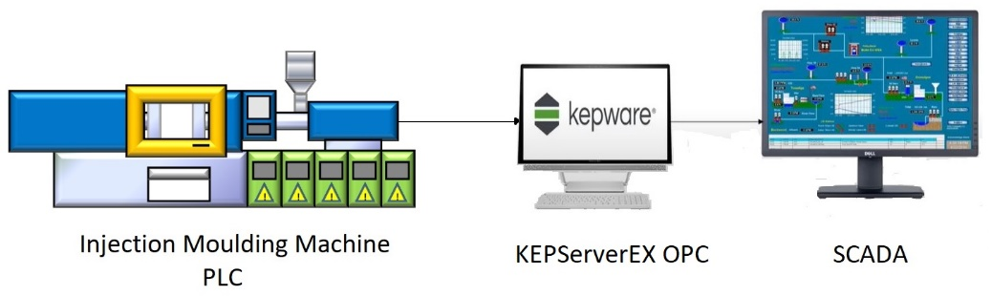
SCADA Application
Port: TCP/IP
Driver: OPC Client
Tags: I/O and Calculations (Type Analog)

Slide 26
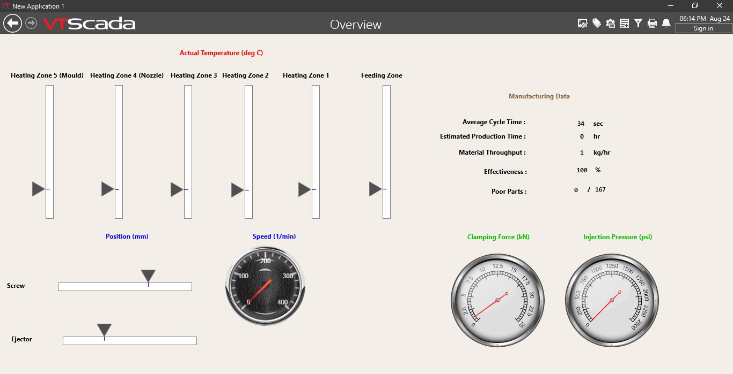

Slide 27
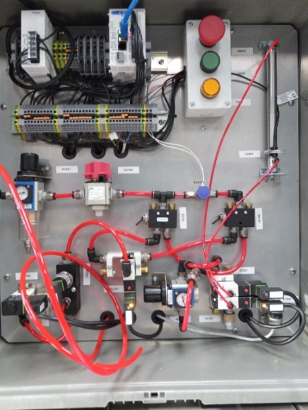
SAMNIAN Automation Kit (Communication Technology and Tags)
It is used for automating pneumatic piston using pneumatic valves
Communication: Modbus TCP connectivity

Slide 28
Sensor Endpoint | Instrumentation Data Sources | Addresses (Data Register Address) | Units | Conversions | Engineering Units
Communication Interface: Modbus TCP Connectivity
Pressure | Pressure sensor (PT-301) | AD1I (DF1) | N/A | N/A | N/A
Piston Position | Ultrasonic position transmitter/sensor (LT-201) | AD2I (DF2) | cm | 1cm = 10 mm | mm
on/off | Pneumatic valve (ZC-201) | Y001 | None | None | None
on/off | Pneumatic valve (ZC-202) | Y002 | None | None | None

Slide 29
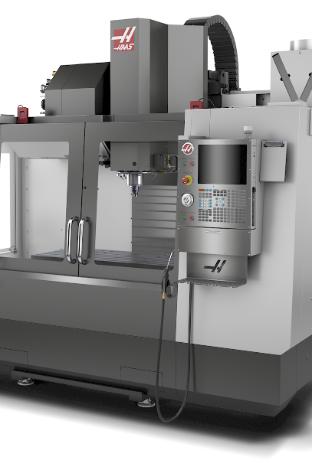
Haas CNC Mill (Communication Technology and Tags)
It uses a rotating cutter which translates and rotates in multiple axis to carve up and create details in the raw workpiece and turn it into a finished part
Communication: Ethernet protocol via TCP Port
DPRNT or Machine Data Collection (MDC) paired with PuTTY
DPRNT prints information (text/variable) either to a file or serial TCP port.
MDC allows the interactive query/extraction of the CNC variable and macros using Q and E commands.
Notes:
DPRNT or Machine Data Collection (MDC) are features included in the CNC program and when paired with PuTTY prints information (text/variable) either to a file or serial TCP port, in the case of DPRNT, or allows the interactive query/extraction of the CNC variable and macros using Q and E commands, in the case of MDC.
Macros provide the added capability of communicating with and extracting information from peripheral devices.

Slide 30
Sensor Endpoint | Instrumentation Data Sources | Addresses (Q600 Commands) | Units | Conversions | Engineering Units
Communication Interface: Ethernet Protocol via TCP (DPRNT or MDC paired with PuTTY allow for printing or query of variables and macros)
Maximum axis loads for X, Y, Z, A, and B Axes, respectively | N/A | Q600 #1064 - #1068 | N | None | N
Spindle load with Haas vector drive | N/A | Q600 #1098 | N | None | N
Maximum axis loads for C, U, V, W, and T-axes respectively | N/A | Q600 #1264 - #1268 | N | None | N
Maximum recorded vibrations of tools 1 through 200 | N/A | Q600 #1801 - #2000 | N/A | N/A | N/A
Tool length offsets of tools 1 through 200 | N/A | Q600 #2001 - #2200 | mm | None | mm
Tool length wear of tools 1 through 200 | N/A | Q600 #2201 - #2400 | mm | None | mm
Tool diameter/radius offsets of tools 1 through 200 | N/A | Q600 #2401 - #2600 | mm | None | mm
Tool diameter/radius wear of tools 1 through 200 | N/A | Q600 #2601 - #2800 | mm | None | mm
Spindle RPM | N/A | Q600 #3027 | rpm | None | rpm
Actual diameter for tools 1 through 200 | N/A | Q600 #3201 - #3400 | mm | None | mm
Tool life monitor counter | N/A | Q600 #5701 - #5800 | None | None | None
Pallet usage count | N/A | Q600 #7801- #7806 | None | None | None
ATM percent of available tool life of all tools in the group | N/A | Q600 #8501 | % | None | %
ATM total available tool usage count in the group | N/A | Q600 #8502 | None | None | None
ATM total available tool hole count in the group | N/A | Q600 #8503 | None | None | None
ATM total available tool feed time (in seconds) in the group | N/A | Q600 #8504 | sec | None | sec
ATM percent of available tool life of the next tool | N/A | Q600 #8511 | % | None | %
ATM available usage count of the next tool | N/A | Q600 #8512 | None | None | None
ATM available hole count of the next tool | N/A | Q600 #8513 | None | None | None
ATM available feed time of the next tool (in seconds) | N/A | Q600 #8514 | sec | None | sec
Coolant level | N/A | Q600 #13013 | N/A | N/A | N/A
Estimated RPM for tools 1 through 200 | N/A | Q600 #50801 - #51000 | rpm | None | rpm
Estimated Feed rate for tools 1 through 200 | N/A | Q600 #51001 - #51200 | rpm | None | rpm
Notes:
ATM – Advanced tool monitoring

Slide 31
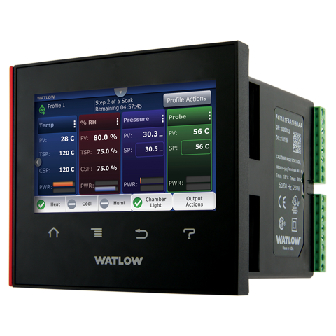
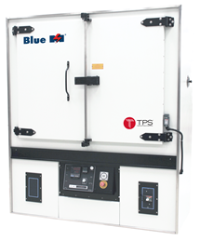
Watlow Temperature and Process Controller (Communication Technology and Tags)
It is used to control a convection oven which used to heat up, remove moisture from product and perform different thermal tests
Communication: Ethernet Modbus TCP connectivity

Slide 32
Sensor Endpoint | Instrumentation Data Sources | Addresses (Absolute) | Units | Conversions | Engineering Units
Communication Interface: Ethernet Modbus TCP connectivity
Monitor the most recent load fault. | N/A | 406253 | N/A | N/A | N/A
Monitor the Timer block for input or timer errors. | N/A | 415051 | % | None | %
Monitor the variable output value. | Thermocouple | 415823 | deg C | None | deg C
Monitor/Set Target Set Point Loop 1 for current step | N/A | 416603 | deg C | None | deg C
Monitor/Set Target Set Point Loop 2 for current step | N/A | 416605 | deg C | None | deg C
Monitor/Set Target Set Point Loop 3 for current step | N/A | 416607 | deg C | None | deg C
Monitor/Set Target Set Point Loop 4 for current step | N/A | 416609 | deg C | None | deg C
Monitor/change ramp rate for control loop 1 | N/A | 416761 | N/A | N/A | deg C/s
Monitor/change ramp rate for control loop 2 | N/A | 416763 | N/A | N/A | deg C/s
Monitor/change ramp rate for control loop 3 | N/A | 416765 | N/A | N/A | deg C/s
Monitor/change ramp rate for control loop 4 | N/A | 416767 | N/A | N/A | deg C/s
Monitor control loop 1 precision | N/A | 416809 | N/A | N/A | N/A
Monitor control loop 2 precision | N/A | 416811 | N/A | N/A | N/A
Monitor control loop 3 precision | N/A | 416813 | N/A | N/A | N/A
Monitor control loop 4 precision | N/A | 416815 | N/A | N/A | N/A

Slide 33
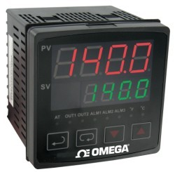
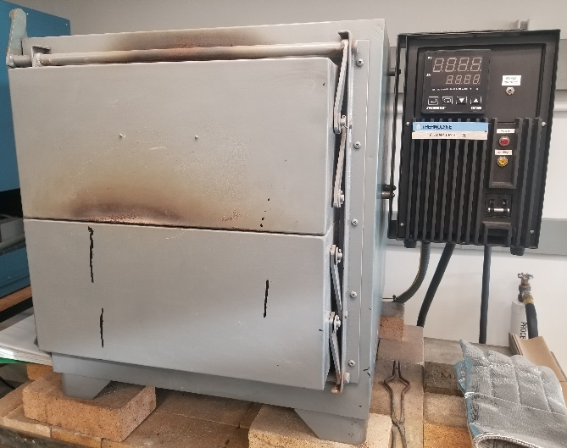
Omega Temperature Process Control (Communication Technology and Tags)
It is used to control the Muffle Furnace which is used for melting down materials in a controlled and airtight environment.
Communication: Modus ASCII or Modbus RTU over RS-485 serial Communications.

Slide 34
Sensor Endpoint | Instrumentation Data Sources | Addresses | Units | Conversions | Engineering Units
Communication Interface: Modus ASCII or Modbus RTU over RS-485 serial Communications
Temperature | Themocouple | 1000H | deg C or deg F | None | deg C
Proportional control offset error value | N/A | 100DH | % | None | %

Slide 35
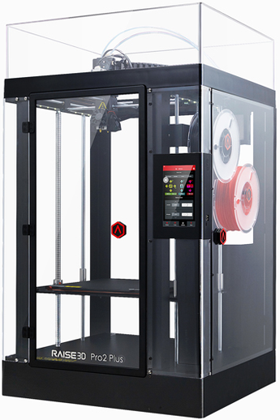
Raise3D Pro2 Plus 3D Printer (Communication Technology and Reports)
It is used for large build volumes, while also still maintaining a high finish resolution and quality
IdeaMaker + RaiseCloud
API is available to log data and generate reports from the printer
RaiseCloud platform provides the status of the printer and several in-dept reports which can be used to gauge the printer’s performance or statistics
Notes:
IdeaMaker connects the printer to the pc and allows the user to import or create CAD files and print them.
RaiseCloud is an online integrated 3D print management ecosystem.

Slide 36
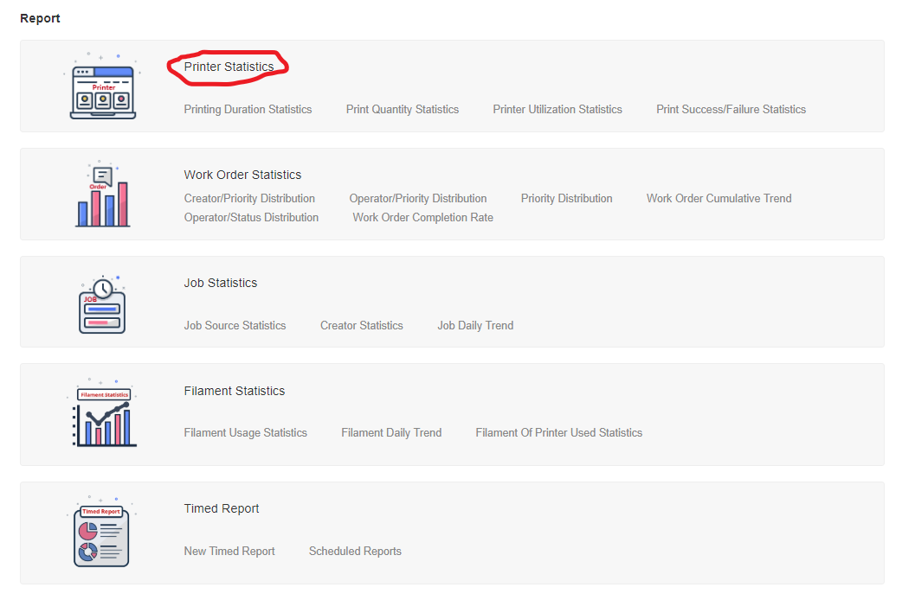

Slide 37
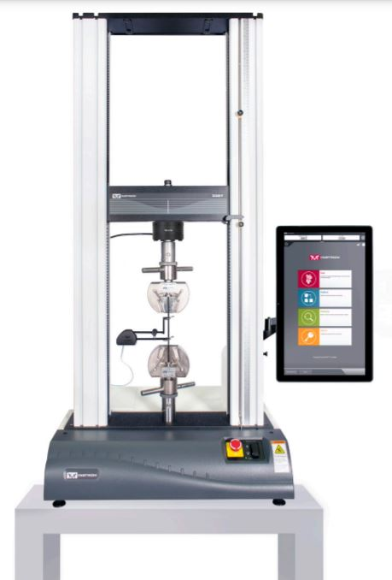
Instron Load Frame (Communication Technology and Tags)
It is used to perform multiple different kinds of static testing such as tensile, compression, bend, shear and other mechanical test and can generate forces of up to 50 kN.
Communication: Bluehill 3 test export into CSV (semi-auto) + custom import script

Slide 38
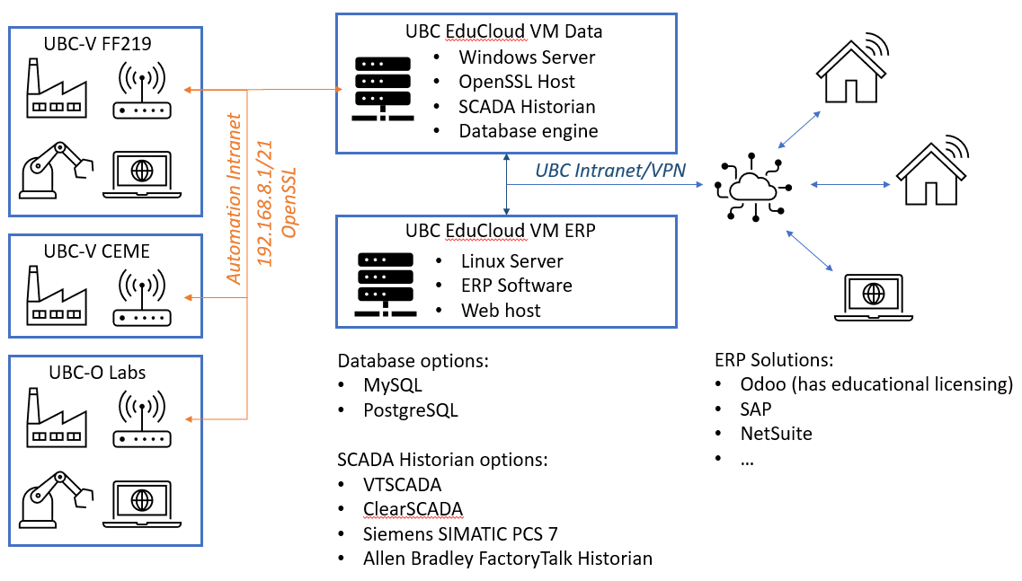
Future Work
Project B: Manufacturing Equipment Data Harvesting
Experiment with changing flow rate to reduce or eliminate oscillations.
Controller design to control the piston speed profile.
Project C: Manufacturing Equipment Data Harvesting
Establish connection between all other equipment and connect to a data server similar to the injection moulding machine.
Investigate ERP Solutions
Establish the rest of the MANU infrastructure

Slide 39

Thank you

